Slide 1
Properties of DNA and RNA molecules for gel fractioning
While double-stranded DNAs adopt an extended rod-like conformation, single-stranded DNAs and RNAs often self-base-pair into complicated secondary structures.
As such, they migrate in gels un-predictive of their molecular weights, unless denaturants are added to resolve their correct size.
so Denaturation of DNA or RNA molecules is a required step prior to resolution of DNA (or RNA) on the gel of choice

Slide 2
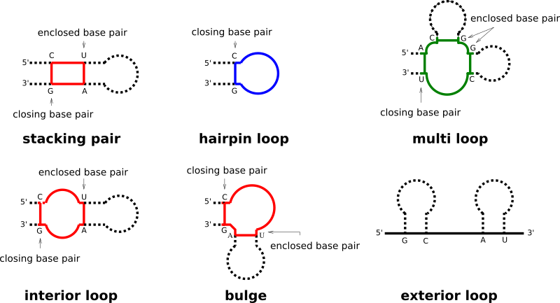
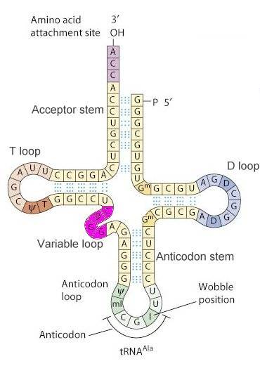
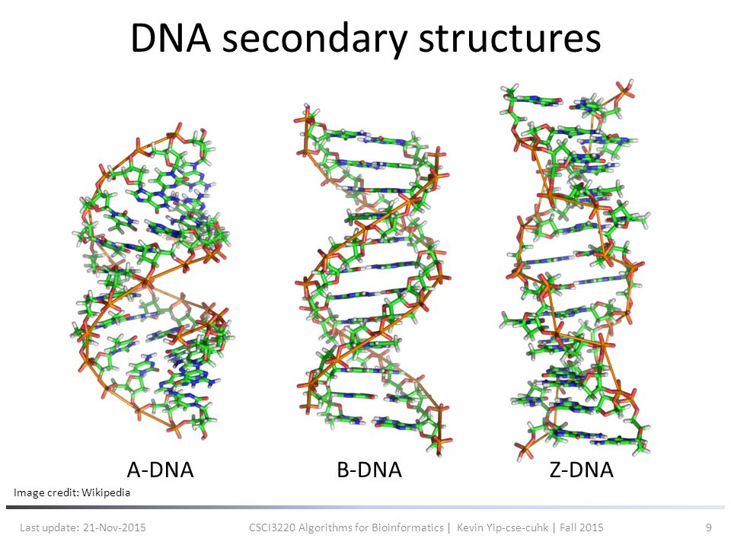
Secondary RNA and DNA Structures
RNA Secondary Structures
tRNA Structure
Credit: David Marcey Cal Lutheran Univ.

Slide 3
CELL SIGNALING
AND
MOTILITY (BIOL 3373)
Lecture 2

Slide 4
Analysis of DNA
Gel electrophoresis through agarose or poly-acrylamide gels is the most common method used to separate, identify and purify DNA fragments.
DNA fragments are negatively charged molecules at neutral pH. Therefore, they will migrate towards the (+) electrode in an electric field.
Both types of gels (agarose or poly-acrylamide) are:
-porous
-function as a molecular sieve
-thereby separate DNAs based on SIZE.

Slide 5
Poly-acrylamide gels
Poly-acrylamide gels are most effective for separating small fragments of DNA (less than 1000 base pairs).
Their resolving power is extremely high, and fragments of DNA that differ in size by as little as 1 base pair can be separated from one another.

Slide 6
Agarose gels
    More porous agarose gels have a lower resolving capacity than polyacrylamide gels.
    Agarose gels however have a greater range of separation.
    DNAs from 100 base pairs to approximately 50 kilo base pairs in length can be separated on agarose gels.
    Most commonly used in the laboratory.

Slide 7
Properties of DNA and RNA molecules for gel fractioning
Both gels can be used to fractionate single-stranded DNA (or RNA molecules) by incorporating chemical denaturants in the gels.

Slide 8
Properties of denaturants:
Frequently used denaturants include:
urea
formamide
formaldehyde
Denaturants compete with and disrupt the hydrogen bonding between base pairs

Slide 9
Visualization of DNA and RNA
Fragments of DNA/RNA can be directly visualized using ethidium bromide (EtBr).
This toxic compound intercalates between the stacked bases of DNA/RNA and fluoresces when UV light is directed onto the gel.
Note: all nucleic acids (DNA and/or RNA) present in a gel are visualized and there is no discrimination based upon sequence.

Slide 10
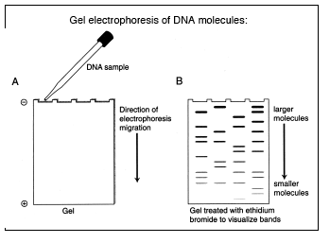
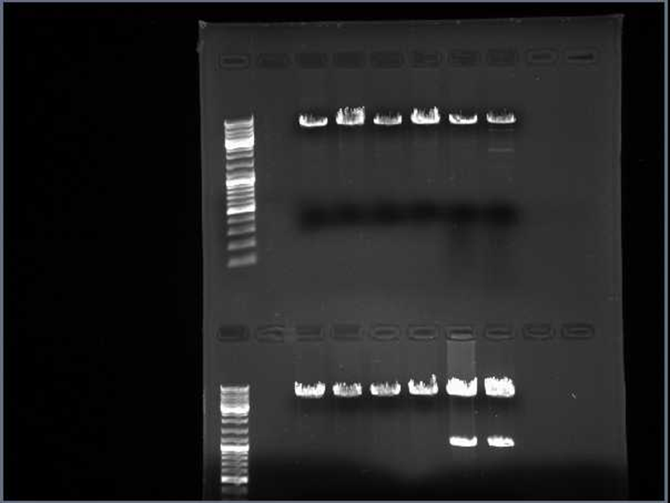
Visualization of DNA with EtBr
(C)
(A)
(B)
Gels are prepared with EtBr prior the migration of DNA/RNA samples.
After Gel electrophoresis (A) fragments of DNA/RNA can be directly visualized under UV light (B) and (C)

Slide 11
Southern Blotting
The technique was developed by E.M. Southern in 1975.
The Southern blot is used to detect the presence of a particular DNA fragment in a sample.
The DNA detected can be a single gene, or it can be part of a larger piece of DNA such as a viral genome.

Slide 12
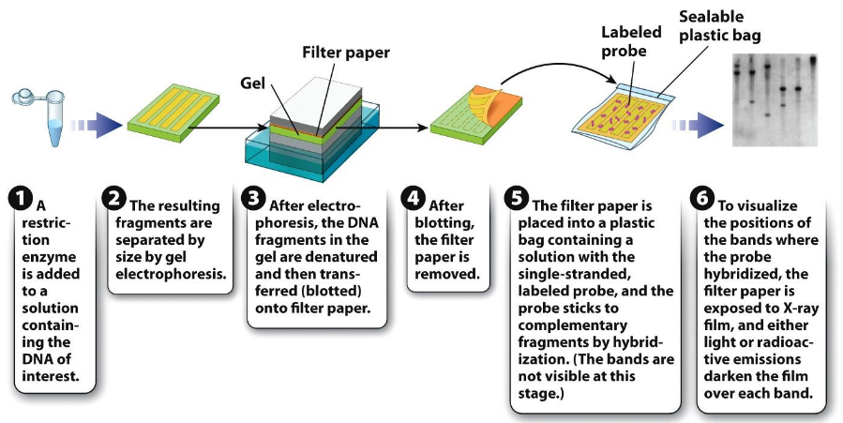
Southern Blotting: PROCEDURE

Slide 13
Southern Blotting
Probes:
Most commonly, the probe is radioactive. Other approaches include chemiluminescent compounds and fluorophores.
In the case of a radioactive probe, the membrane is exposed to X-ray film (autoradiography) and the film darkens where there is a concentration of radioactivity.
Chemiluminescent and fluorophores require specific wavelengths of light for detection.

Slide 14
Southern Blotting
Southern blot hybridization can be used to follow the inheritance of selected genes.
Because the genomic DNA samples are fractionated by separation of restriction fragments according to size, mutations which alter a restriction site, and significantly large deletions or insertions occurring between neighboring restriction sites, can be detected.
Such mutations will change the size of restriction fragments and the positions of bands in Southern blot analysis. This is called Restriction Fragment Length Polymorphism (RFLP).

Slide 15
RFLP
Restriction Fragment Length Polymorphism
The existence of two or more variants at significant frequencies in the population is called polymorphism.
RFLP has been widely used in direct detection of disease-causing mutation, DNA fingerprinting, and linkage of polymorphism with gene mutation.

Slide 16
    RFLPs commonly result from two types of DNA variants:
    Base changes in nucleotide sequence abolish existing restriction sites or create new restriction sites.
    Upon cleavage with restriction enzyme, a different band pattern (change in size) will be revealed in Southern blot hybridization.
    The change in size detected on the gel will be dependent on the effect of the base change, i.e. if a new site is created or a site is abolished.

Slide 17
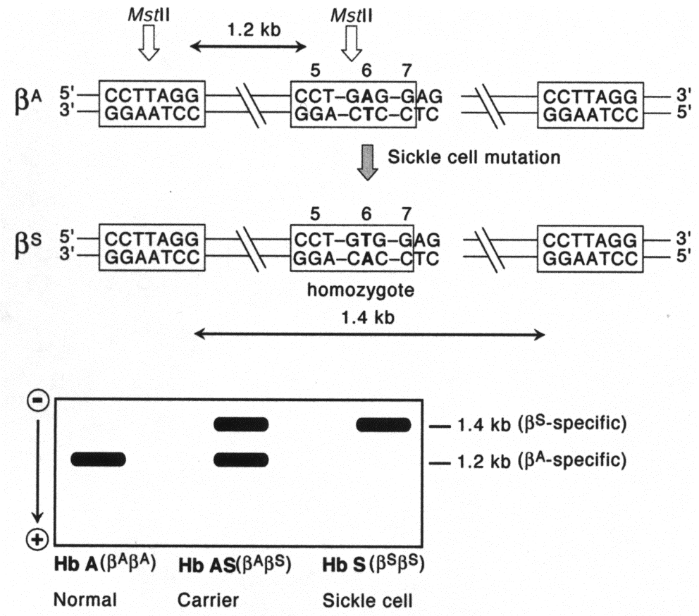
Example of RFLP: Sickel cell Mutation
Sickel cell mutation: The restriction enzyme Mst II recognizes and cleaves at the sequence CCTNAGG (where N is any nucleotide). The A to T mutation within the codon 6 of the β-globin gene eliminates a cleavage site for the enzyme and generates a disease-specific RFLP.

Slide 18
Fluorescence in situ Hybridization

Slide 19
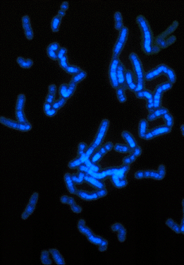
Fluorescence in situ Hybridization (FISH)
FISH - a process which stains chromosomes or portions of chromosomes with fluorescent molecules
Figure : chromosomes in metaphase stained with the fluorescent molecule DAPI

Slide 20
USE of FISH: to identify the presence and location of a region of DNA or RNA within chromosome preparations, fixed cells or tissue sections
MEDICAL USE of FISH: to Identify chromosomal abnormalities; analysis of chromosome structural aberrations and ploidy determination. gene mapping studies, toxicological studies.

Slide 21
Advantage of FISH:
less labor-intensive method for confirming the presence of a DNA segment within an entire genome than other conventional methods like Southern blotting

Slide 22
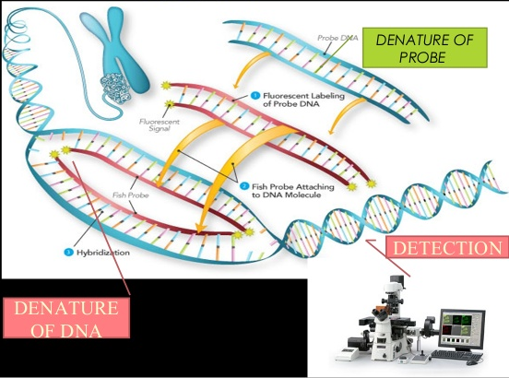
1. Denature the chromosomes
2. Denature the probe
3. Hybridization
4. Fluorescence staining
5. Examine slides or store in the dark
FISH PROCEDURE:
2
4
3
5
1

Slide 23
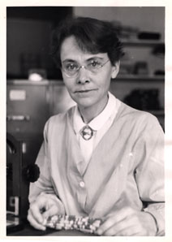
Transposable Elements
(or, Jumping Genes)
For the first half of the 20th century, genes were seen as objects with fixed positions on the chromosomes.
However, in the 1950s, Barbara McClintock showed in maize that certain DNA fragments, termed transposons, can be activated to "jump" from one position on a chromosome to another.
She identified a particular chromosome breakage event that always occurred at the same locus on maize chromosome 9, which she named the "Ds" or "dissociation" locus.
Barbara McClintock was awarded Nobel Prize in Physiology or Medicine, in the 1983

Slide 24
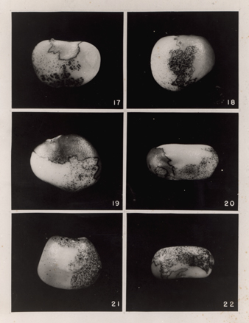
Transposable Elements
The plants containing a broken chromosome 9 , showed stripes and spots of color, an indication that mutations had taken place in the developing body of the plant.

Slide 25
Philadelphia (Ph) chromosome
Philadelphia (Ph) chromosome triggers a cancerous disease called
Chronic Myeloid Leukemia (CML)

Slide 26
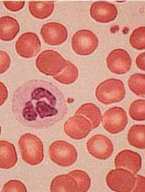
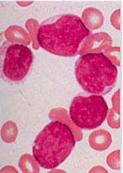
Leukemia is characterized by
hyper-proliferation
of immature white blood cells
normal person
Leukemic patient
red blood cells
white blood cell
hyperproliferation of white blood cells

Slide 27
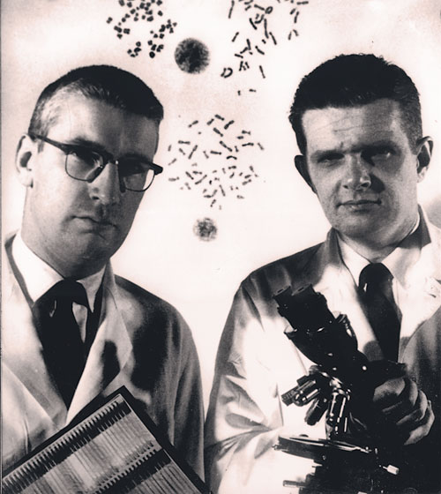
Discovery of Philadelphia (Ph) chromosome
In 1960, Peter Nowell’s work at the University of Pennsylvania School of Medicine, together with the late David Hungerford from the Fox Chase Cancer Center’s Institute for Cancer Research, established that patients with a form of leukemia had cells containing an abnormally small chromosome, soon named the Philadelphia chromosome

Slide 28
The Philadelphia (Ph) chromosome derives from translocation of a segment of the Chr. 9 to the Chr. 22.
In normal individual Chr. 9 carries abl gene while Chr. 22 has the bcr gene.
9; 22 Translocation fuses bcr and abl genes.
normal individual
Leukemic patient
bcr
Bcr-abl
Chr. 22
abl
Chr. 9
De Klein et al. Nature 300, 765 (1982)
Groffen et al. Cell 36, 93 (1984)

Slide 29
BCR-Abl fusion affects multiple cell functions
Proliferation & differentiation
Stem cell turnover
G
S
2
M
BCR-Abl
G
1
G₀
Cytoskeleton/
adhesion defects
Adapted from Jörgensen, 2001. Hem. Onc.
Apoptosis

Slide 30
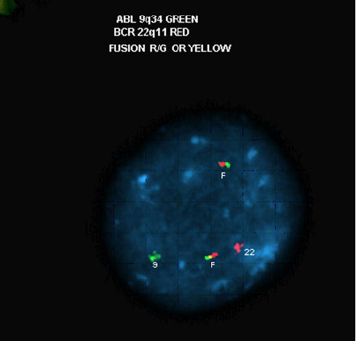
Fluorescence In Situ Hybridization (FISH)
a tool for diagnosing CML
fusion 9
abl/bcr
fusion 22
bcr/abl
abl
bcr
Notes:
30

Slide 31
Retinoblastoma

Slide 32
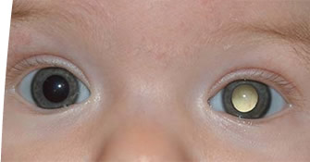
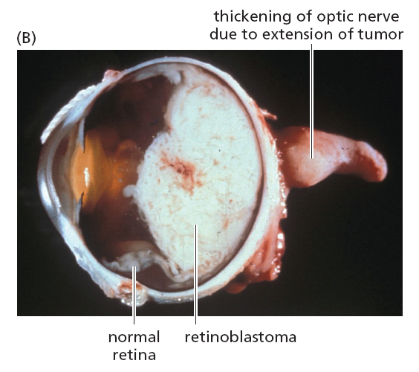
Retinoblastoma is a cancerous disease in child
Typically presents in first 2-3 years of life.
Retinoblasts fail to differentiate - continue to divide, forming tumors in the retina.
Retinoblastoma diplays a condition called Leukocoria or “white pupil”

Slide 33
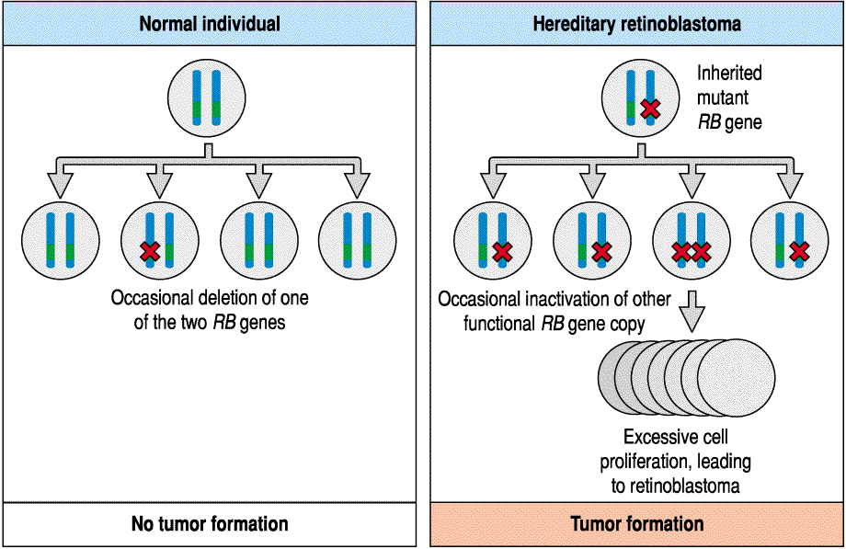
Retinoblastoma is caused by recessive mutation of retinoblastoma protein (RB1) localized on the Chr 13

Slide 34
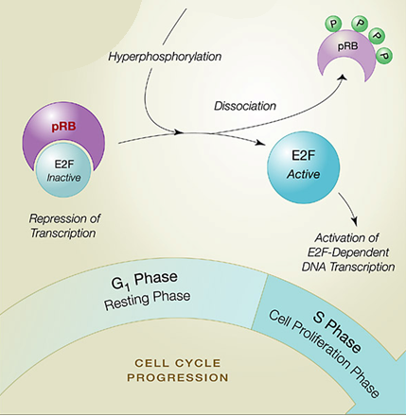
RB1 function: in normal cell the retinoblastoma protein regulates the cell cycle
Cell cycle = OFF
Rb binds to E2F: no transcription, no entry into S phase
Cell cycle = ON
Rb does not bind to E2F: transcription and entry into S phase
Mutation of RB1: no cell cycle arrest, cells proliferate indefinitely, can induce Cancer

Slide 35
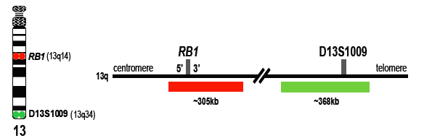
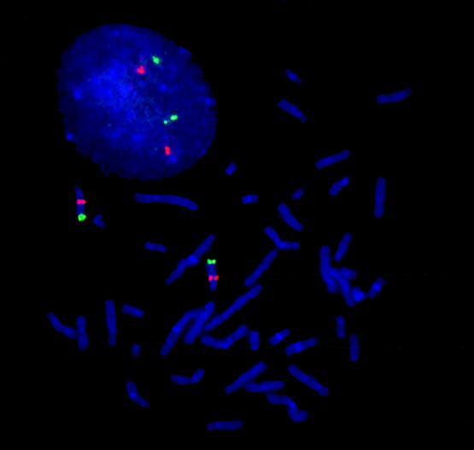
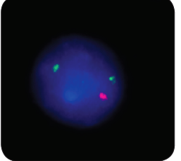
FISH analysis of RB1 gene.
Horizontal red and green bars indicate the regions covered by the probes The RB1 probe (red) spans the entire gene while the D13S1009 probe (green) hybridizes to the region surrounding the D13S1009 locus marker and serves as a control Figure 1).
Figure 1
In normal diploid interphase nuclei and metaphase chromosomes, the probe generates two red and two green signals corresponding to the two normal chromosomes 13 (Figure 2).
In cells with interstitial deletion of chromosome 13, in which the RB1 locus is deleted and the D13S1009 locus is retained, one red (RB1) and two green (D13S1009) signals will be observed (Figure 3).
Figure 2
Figure 3

Slide 36
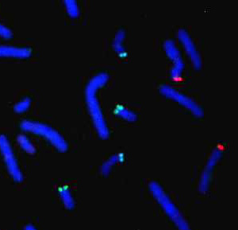
FISH and Telomeres
Special telomeric probes specific to individual chromosomes have been designed
Probe is based on the TTAGGG repeat present on all human telomeres

Slide 37
FISH and Telomeres
Application in cytogenetics - can detect submicroscopic deletions and cryptic translocations of genes associated with unexplained mental retardation and miscarriages

Slide 38
Analysis of RNA
Gel electrophoresis through agarose gel
RNA fragments are negatively charged molecules at neutral pH. Therefore, they will migrate towards the (+) electrode in an electric field.

Slide 39
Northern Blotting
The technique was developed by Alwine and his colleagues in 1979
Technique for detecting specific RNAs separated by electrophoresis by hybridization to a labeled DNA probe.

Slide 40
Northern Blotting
RNA
Gel electrophoresis
Transfer to membrane
Probed with complimentary cDNA
Autoradiography

Slide 41
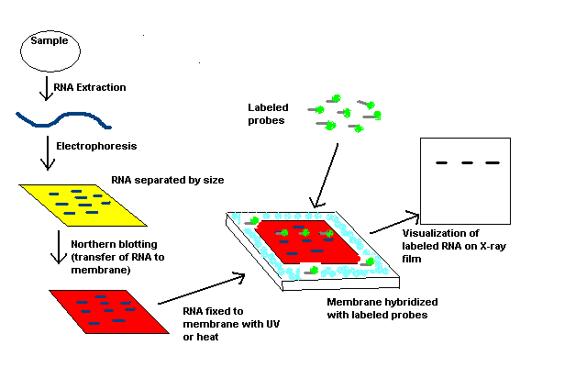
Northern Blotting

Slide 42
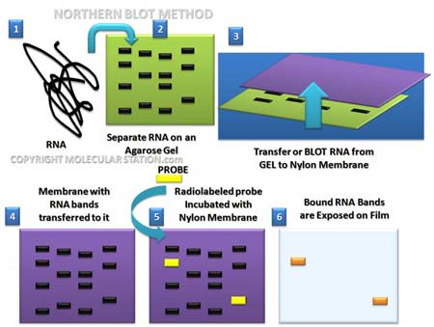
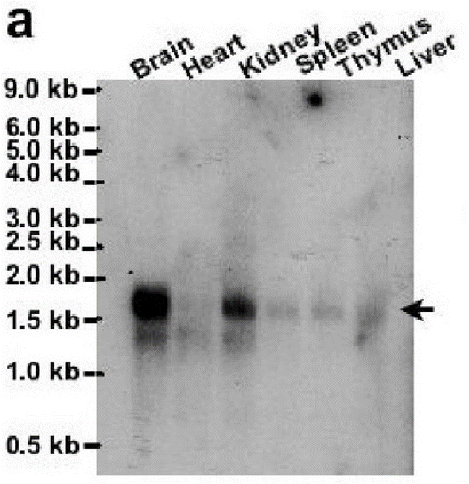
Northern Blotting

Slide 43
Analysis of RNA
RNA especially has secondary structure that impedes its migration.
Agarose gels can be used to fractionate single-stranded RNA molecules by incorporating chemical denaturants in the gels.
Required step prior to resolution of RNA on the gel of choice.

Slide 44
Uses for Northern Blots?
1. Temporal expression of genes.
2. Spatial expression of genes
3. Tissue specific expression of genes
4. Splicing isoforms of genes

Slide 45
    Analysis of Protein

Slide 46
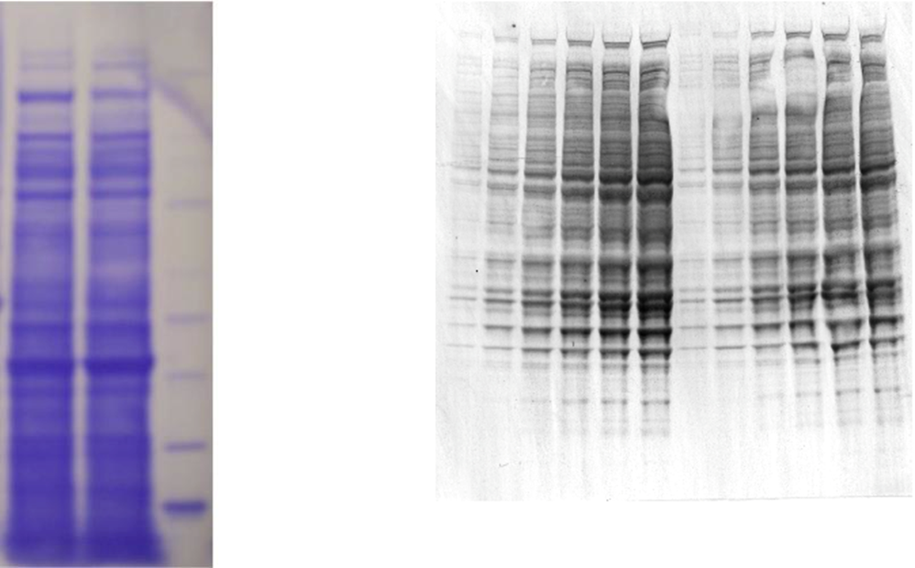
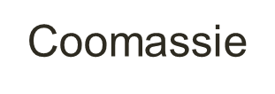

Detection of Proteins
Coomassie Stain: 0.5 ug protein.
Silver Stain: 0.25 ng protein.
Resolved through polyacrylamide gels with SDS.

Slide 47
Western Blotting
Protein
Gel electrophoresis
Transfer to membrane
Probed with antibody
Chromogenic reaction

Slide 48
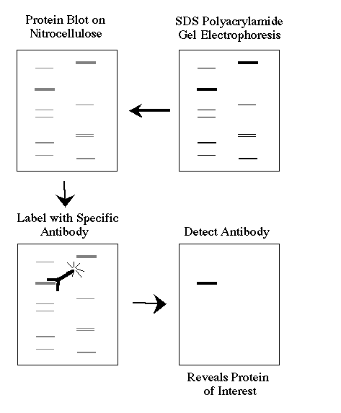
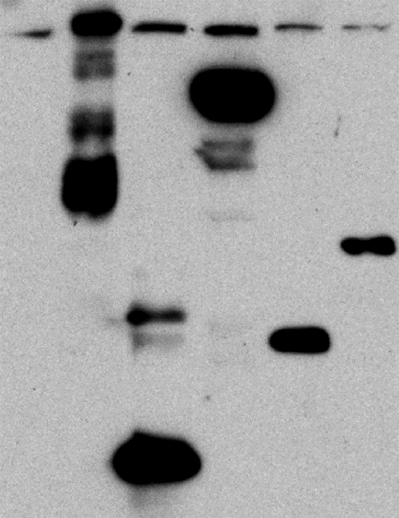
Western Botting

Slide 49
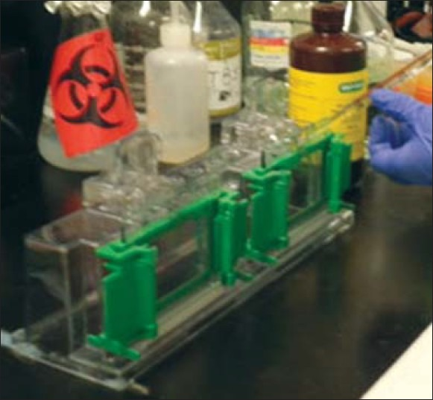
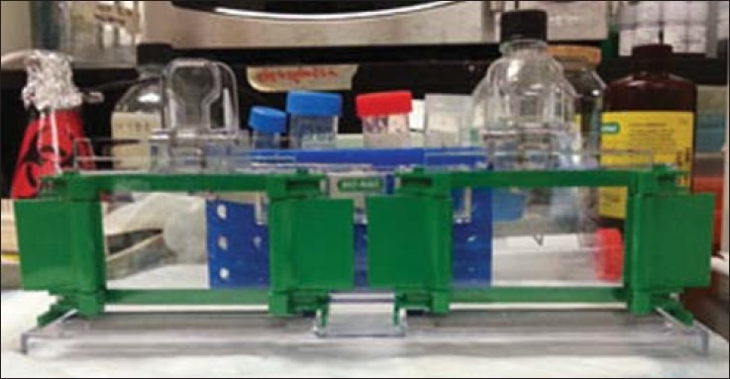
Western Blotting
1 step : Gels are usually made by pouring them between two glass or plastic plates, using the gel solution. Western blot uses two different types of agarose gel: stacking and separating gel. The higher, stacking gel is slightly acidic (pH 6.8) and has a lower acrylamide concentration making a porous gel, which separates protein poorly but allows them to form thin, sharply defined bands. The lower gel, called the separating, or resolving gel, is basic (pH 8.8), and has a higher polyacrylamide content, making the gel's pores narrower.

Slide 50
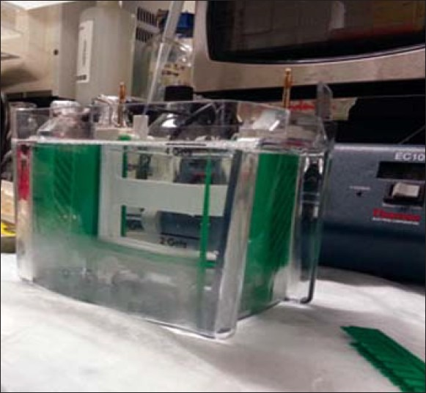
Western Blotting
2 step : The samples are loaded into the wells, and the empty wells are loaded with sample buffer. The gel is then connected to the power supply and allowed to run. The proteins when loaded on the gel have a negative charge, as they have been denatured by heating, and will travel toward the positive electrode when a voltage is applied

Slide 51
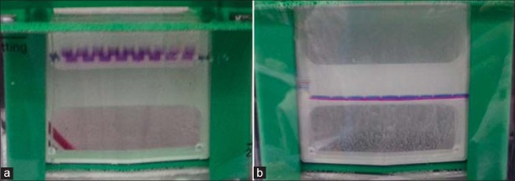
Western Blotting
3 step : samples run through the stacking gel (a) and separate by their size through the separating gel (b). Smaller proteins travel more easily, and hence rapidly, than larger proteins

Slide 52
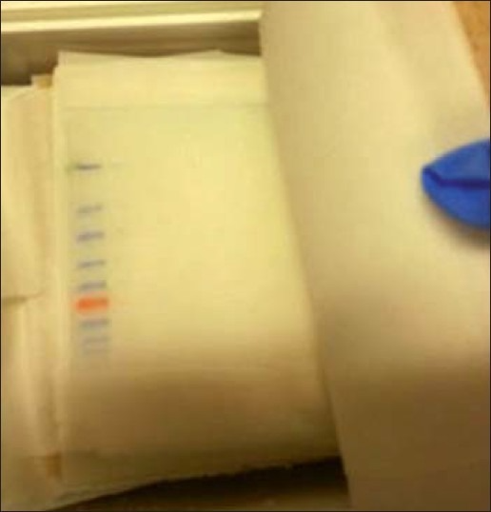
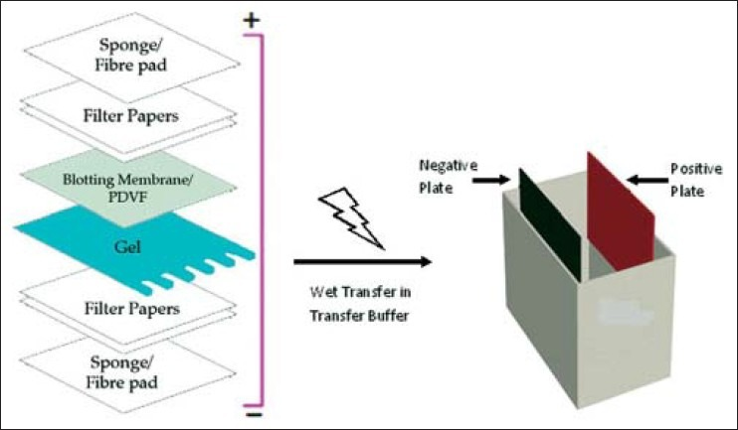
Western Blotting
4 step :after separating the protein mixture, it is transferred to a membrane. The transfer is done using an electric field orientated perpendicular to the surface of the gel, causing protein to move out of the gel and onto the membrane. The membrane is placed between the gel surface and the positive electrode in a sandwich.
Sandwich
Membrane after the transfer

Slide 53
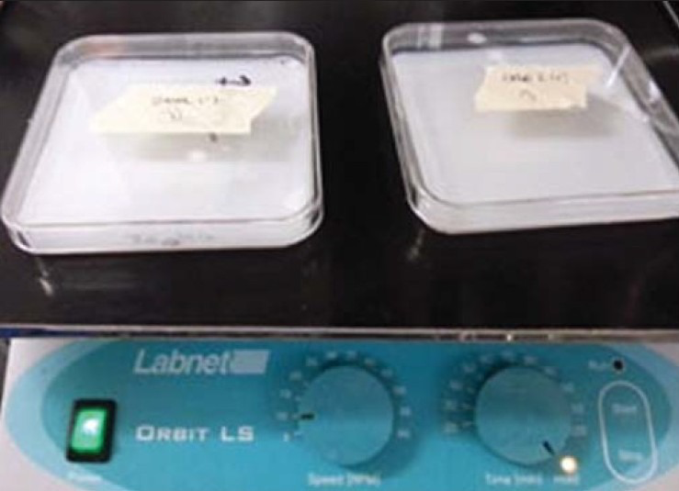
Western Blotting
5 step :after the transfer, the membrane is incubated with a specific antibody, which can be diluted in a buffer containing milk or BSA

Slide 54
Antibodies
Highly specific.
Monoclonal versus polyclonal.
Recognizes 8-10 amino acids.
But not only sequence but conformation.
Excellent for probes when coupled to chromogenic reactions.

Slide 55
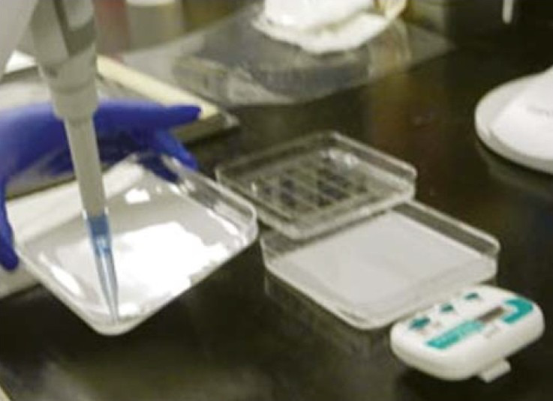
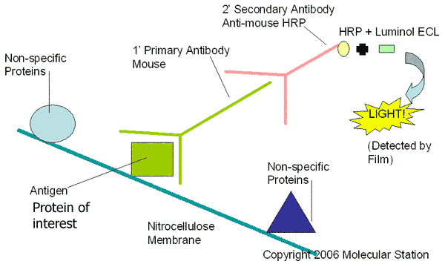
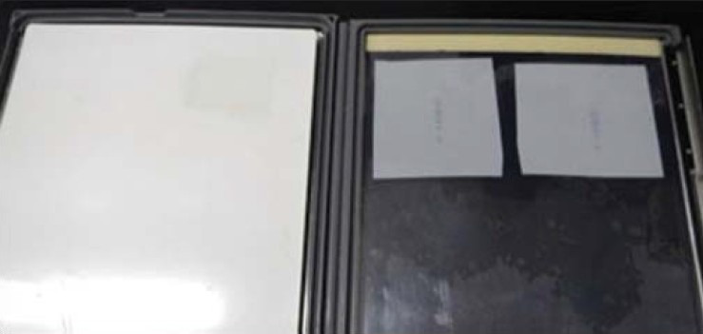
Western Blotting
7 step :The membrane is then detected using the label antibody, usually with an enzyme such as horseradish peroxidase (HRP), which is detected by the signal it produces corresponding to the position of the target protein. This signal is captured on a film which is usually developed in a dark room.

Slide 56
Uses for Western Blots?
1. Temporal expression
2. Spatial expression
3. Tissue specific expression
4. Protein modifications

Slide 57
Two-dimensional gel electrophoresis (2-DE)

Slide 58
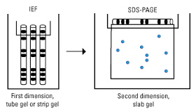
Two-dimensional gel electrophoresis (2-DE) is a gel electrophoresis used to analyze mixture of proteins by two properties in two dimensions .
2-D electrophoresis begins with 1-D electrophoresis and then separates the molecules by a second property in a direction 90 degrees from the first.
Generally, it is unlikely that two molecules will be similar in both two distinct properties, so molecules are more effectively separated in 2-D electrophoresis than in 1-D electrophoresis.

Slide 59
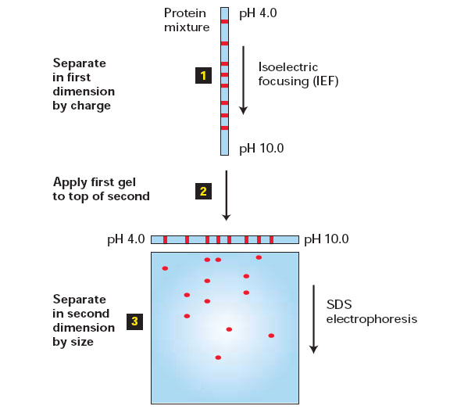
Two-dimensional gel electrophoresis (2-DE): Procedure
In IEF the proteins applied in the first dimension will move along the gel and accumulate at their isoelectric point: is the point at which the protein has a neutral charge.
Before separating the proteins by mass in the second dimension, they are denaturated with SDS and reducing reagents . Proteins will become unfolded and negatively charged
In the second dimension, an electric potential is applied at a 90 degree angle from the first field (SDS electrophoresis).
The gel acts like a molecular sieve when the current is applied, separating the proteins on the basis of their molecular weight with larger proteins being retained higher in the gel and smaller proteins being able to pass through the sieve and reach lower regions of the gel.

Slide 60
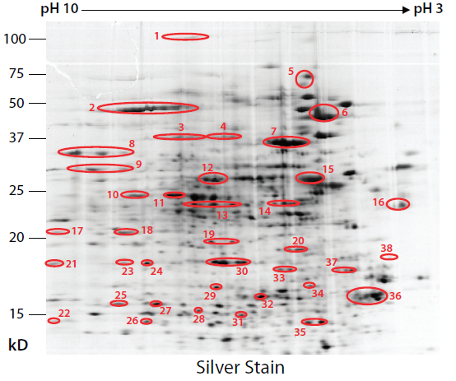
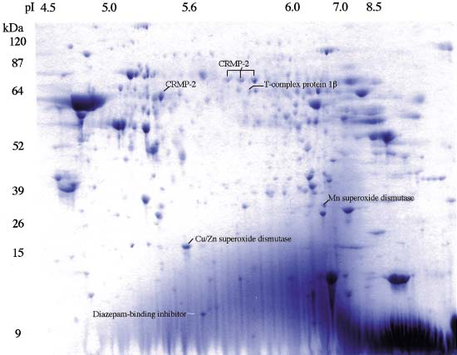
Two-dimensional gel electrophoresis (2-DE): Staining
These proteins can then be detected by different stains but the most commonly used stains are silver and coomassie brilliant blue staining.
coomassie brilliant blue staining

Slide 61
Two-dimensional gel electrophoresis (2-DE)
2-DE is a widely used method for the analysis of complex protein mixtures extracted from cells, tissues, or other biological samples.
This technique sorts proteins according to two independent properties in two discrete steps. Each spot on the resulting two-dimensional array corresponds to a single protein species in the sample.
Thus thousands of different proteins can be separated, and information including the protein pI, the apparent molecular weight, and the amount of each protein is obtained.

Slide 62
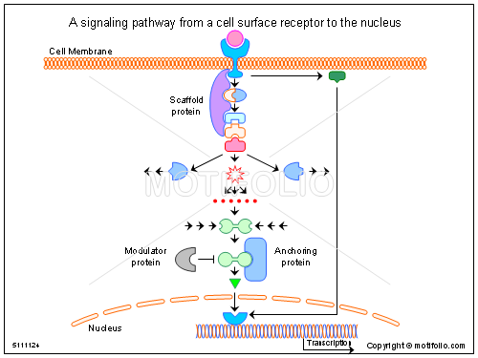
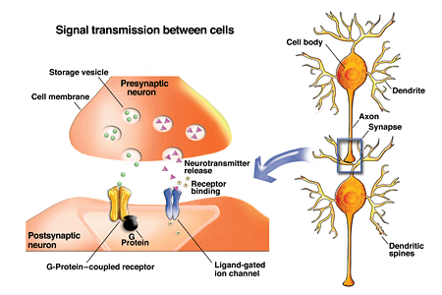

    Protein- Protein Interaction (PPI)
    Proteins control biological signals within the cell (A) or between cells (B)
(A)

Slide 63
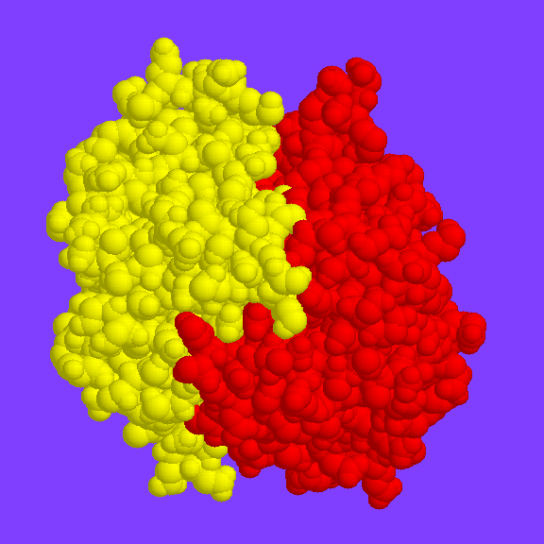
Protein- Protein Interaction (PPI)
Many proteins perform their activity independently, but the vast majority of proteins interact with others for proper biological functions
example of protein interaction
Characterizing protein-protein interactions is essential to understand protein function and the biology of the cell

Slide 64
How to study protein- protein interaction?

Slide 65
Overview of Techniques to study PPI
Gel filtration
Far western blot
Affinity chromatography
Co-immunopercipitation
Capillary elecrophoresis
Biosensor
FRET microscopy
Confocal microscopy
2 hybrid assay
Protein microarry
Maspec
NMR
Co-crystallization for crystallography

Slide 66
Far western blot
The far-Western blot technique is similar to Western blotting:
in a Western blot, an antibody is used to detect the corresponding antigen on a membrane
In far-Western analysis, a labeled or antibody that detced a "bait" protein is used to probe and a target "prey" protein on the membrane.

Slide 67
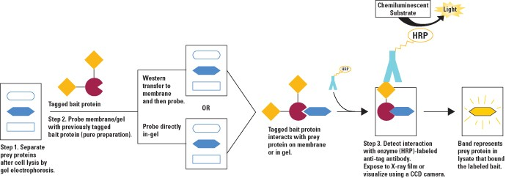
Far western blot :Procedure

Slide 68
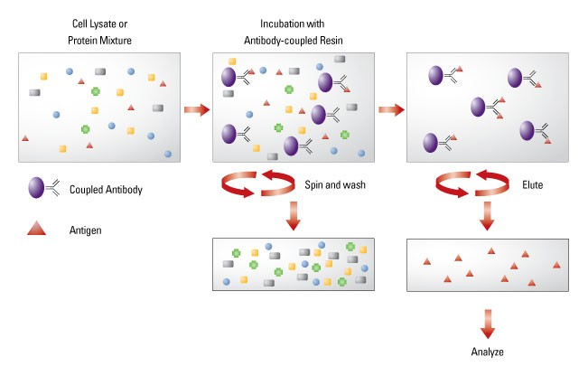
IMMUNOPRECIPITATION (IP)
Immunoprecipitation is one of the most widely used methods for antigen detection and purification
PROCEDURE:
1. an antibody against a specific target protein forms an immune complex with that target in a cell lysate.
2. The immune complex is precipitated, on a beaded support to which an antibody-binding protein is immobilized (such as Protein A or G), and any proteins not precipitated on the beads are washed away.
3. Finally, the antigen is eluted from the support and analyzed by sodium dodecyl sulfate-polyacrylamide gel electrophoresis (SDS-PAGE), often followed by Western blot detection to verify the identity of the antigen.

Slide 69
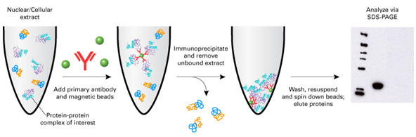
Co-IMMUNOPRECIPITATION (IP)
Co-immunoprecipitation is an extension of IP that is based on the potential of IP reactions to capture and purify the primary target (i.e., the antigen) as well as other macromolecules that are bound to the target by native interactions in the sample solution.
immuno-precipitate
A protein complex is detected within a protein mixture by using an antibody that binds specifically for one of the protein of the complex, forming a immuno-precipitate.
The immunoprecipitate is eluted from the support and analyzed by sodium dodecyl sulfate-polyacrylamide gel electrophoresis (SDS-PAGE), often followed by Western blot detection to verify the identity of the antigen.

Slide 70

Co-immunoprecipitation of transferrin and transferrin receptor protein (CD71)
Lane 1. Chemiluminescent MW Marker,
Lane 2. Agarose bead control,
Lane 3. 50ng purified transferrin,
Lane 4. the Co-IP sample
A
B
Samples were co-immunoprecipitated with anti-CD71 antibody immobilized to agarose beads.
Upon elution the samples were separated by 4-12% SDS-PAGE transferred to nitrocellulose for Western blotting.
Western blot (A) was probed with anti-CD71 antibody followed by Goat anti-Mouse-HRP and detected by Chemiluminescence
Western blot (B) was probed with anti-human transferrin antibody followed bRabbit anti-Chicken-HRP and by Chemiluminescence.

Slide 71

Confocal microscopy
A good technique to detect intracellular co-localization of proteins
Point scan laser system minimizes overlaps in image (perfect for imaging Co-localization of proteins)

Slide 72
MICROSCOPY

Slide 73

Light Microscopy
With a history of 350 yrs since its initial form of Anthony van Leewenhoek’s magnifier, the microscope has developed into a complex, sophisticated instrument
It creates a magnified image of objects based on light transmission, absorption, diffraction and refraction

Slide 74

Upright Microscope
Upright microscopes are constructed with the tip of the objective pointing downward so as to view the specimen from above.
• Light is directed on the specimen from below.
• This type of microscope is suitable for viewing prepared slides.
Epi-
illumination
Source
Brightfield
Source

Slide 75

Inverted Microscope
Brightfield
Source
Epi-
illumination
Source
Inverted microscopes are constructed with the tip of the objective pointing upward so as to view the specimen from below.
• The objective is underneath the stage and light is directed on the specimen from above.
• This type of microscope is suitable for viewing culture vessels such as Petri dishes.

Slide 76
Fluorescence Microscopy
It is based on the ability of many organic and inorganic substances to display primary fluorescence: absorb light radiation of a specific spectral region and emit radiation of longer wavelength
Tissues and cellular components are labeled directly or indirectly (e.g. antibodies) with specific fluorochromes and visualized under a fluorescent microscope equipped with an appropriate light-source (Hg arc or Xe-lamp), excitation and emission filters of corresponding wavelength window
Excitation and/or emission wavelengths of certain fluorochromes can reflect physiological, physical and/or chemical changes

Slide 77
Fluorescence Microscopy
Fluorescent microscopy can be applied to live specimens:
  Purified proteins, derivatized with fluorophores and retaining function may be injected into a cell
  Proteins fused to naturally fluorescent proteins, such as green or yellow fluorescent protein (GFP and YFP) can be expressed ectopically in cells
  Two interacting proteins, each fused with one of two portions of GFP can be expressed ectopically in cells, reconstituting GFP fluorescence upon interaction
  Fluorescent indicator molecules changing their optical properties at different physiological conditions: probes for Ca⁺⁺, pH, ATP, membrane potential

Slide 78


Fluorescence Microscope
upright
inverted

Slide 79



Light microscopy and imaging of specimens of different thickness
40X
A
A
B
20 μm
Phase-contrast of live primary mammary epithelial cells (MECs) in collagen-culture
20X
B
C
D
100 μm
Phase-contrast (A) and epifluorescence of fixed
Bright field: A. H&E staining of 5 μm-section of a rat ovarian LMP; B. Anti-p53 IHC of OAdCA
3D MEC structures in culture: B. DNA stained with Hoëchst; C. Actin network stained with Texas-red phalloidin; D. Integrin α5 stained with Alexa-green Ab

Slide 80
Confocal Microscopy
The resolving power of the conventional light microscope is limiting for imaging specimens thicker than 5 mm
Optical sectioning can be achieved using a Confocal microscope
  Confocal Microscope is A laser-scanning microscope that allow to take images at multiple sequential confocal planes.
  After the capture of images at several layers a 3D image of the specimen can be obtained and the can be reconstituted to higher clarity.

Slide 81

Fluorescence confocal microscopy
Visualization of the two X chromosomes (green) by chromosome painting in a female fibroblast and a pre-mRNA splicing factor (red) by immunostaining. Only the transcriptionally active X chromosome is associated with splicing factors

Slide 82
Electron microscopy
Light microscopy has a limit in achievable resolution because of diffraction and the wavelength of the illuminating medium.
To better understand changes in subcellular components during different biological processes (DNA replication and transcription, protein translation, vesicular formation and trafficking, etc) higher resolutions are necessary
An electron microscope can theoretically achieve a resolution of ~0.24nm, although in practice, due to limitations in biological specimen preparation this is ~2nm

Slide 83

An electron micrograph of the mitochondrion

