Slide 1
Adipocyte Derived Stroma Cells
Their usage in regenerative medicine and transformation into beta like cells
By Evelina Cohn

Slide 2
Macroscopically, at least 5 different types of adipose tissue exist: bone marrow, brown, mammary, mechanical, and white. Each serves a distinct biological function. In the bone marrow, adipose tissue serves both a passive and active role. It occupies space no longer required for hematopoiesis and
serves as an energy reservoir and cytokine source for osteogenic and hematopoietic events. Brown adipose tissue is thermogenic, generating heat through the expression of a unique uncoupling protein that short circuits the mitochondrial pH gradient. Whereas brown adipose tissue is found around the major organs (heart, kidney, aorta, gonads) in the newborn infant, it disappears as humans mature.
Mechanical adipose depots, such as the retro-orbital and palmar fat pads, provide support to the eye, hand, and other critical structures. Finally, white adipose tissue serves to store energy and provide insulation. There is now a greater appreciation of the role of white and other adipose tissues as an endocrine organ in its own right. Adipose secretion of adiponectin, leptin, resistin, and other adipokines exerts systemic physiological and pathological effects.
Whereas multipotent stem cells are abundant within murine white adipose tissue, their numbers and differentiation potential are reduced in brown adipose tissue. In humans, differences in stem cell recovery have been noted between subcutaneous white adipose tissue depots, with the greatest numbers recovered from the arm as compared with the thigh, abdomen, and breast.

Slide 3
Cell Isolation and Mechanical Device
Adipose-derived stem cells (ADSC) are multipotent and hold promise for a range of therapeutic applications.
The initial methods to isolate cells from adipose tissue were pioneered by Rodbell and Rodbell and Jones in the 1960s. They minced rat fat pads, washed extensively to remove contaminating hematopoietic cells, incubated the tissue fragments with collagenase, and centrifuged the digest, thereby separating the floating population of mature adipocytes from the pelleted stromal vascular fraction (SVF) The SVF consisted of a heterogeneous cell population, including circulating blood cells, fibroblasts, pericytes, and endothelial cells as well as “preadipocytes” or adipocyte progenitors.

Slide 4
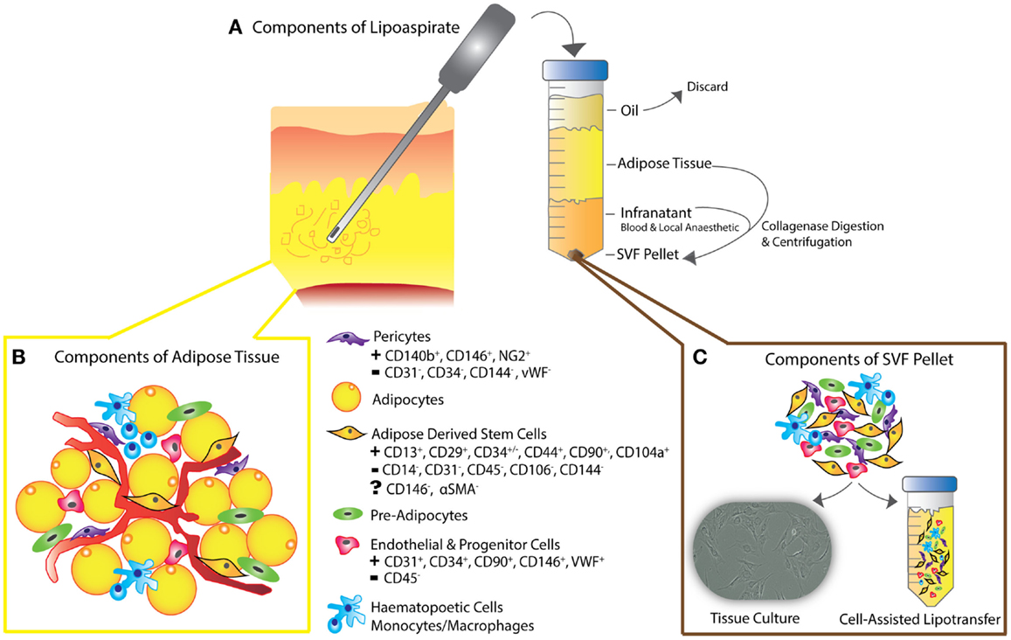
SVF=Stromal Vascular Fraction
Pericytes= contractile cells around that wrap around endothelial cells, capillaries and venules on the entire body
http://www.frontiersin.org/files/Articles/123490/fsurg-02-00001-HTML-r1/image_m/fsurg-02-00001-g002.jpg

Slide 5
ADSCs (Adipocytes Derived Stem Cells) express characteristic adhesion and receptor molecules, surface enzymes, extracellular matrix and cytoskeletal proteins, and proteins associated with the stromal cell phenotype. Despite any differences in the isolation and culture procedures, the immunophenotype is relatively consistent between laboratories.
Indeed, the surface immunophenotype of ADSCs resembles that of bone marrow–derived mesenchymal stem or stromal cells (MSCs) and skeletal muscle-derived cells. Direct comparisons between human ADSC and MSC immunophenotypes are 90% identical. Consistent with this, the 2 cell populations display similar mitogen-activated protein kinase phosphorylation in response to tumor necrosis factor-, lipolytic responses to -adrenergic agents, and adiponectin and leptin secretion following adipogenesis. Nevertheless, differences in surface protein expression have been noted between ASCs and MSCs. For example, the
glycoprotein CD34 is present on human ADSCs early in passage but has not been found on MSCs.

Slide 6
Reprograming of human pre-adipocytes by ectopic overexpression of lentivirus. Lentivirus that overexpresses two factor (Oct4, Klf4) or four iPS factor (OSKM) was infected into human pre-adipocytes. Cells were maintained on MEF cell supplemented with the mTeSR1 medium.
It was reported that human adipocyte derived stem cells, ADSCs can differentiate into insulin-producing cells in vitro under specific medium conditions and that these cells express pancreatic developmental genes including Isl-1, Ipf-1, and Ngn-3 as well as the islet hormone genes, glucagon and somatostatin, although studies on the function of these differentiated cells are lacking.

Slide 7
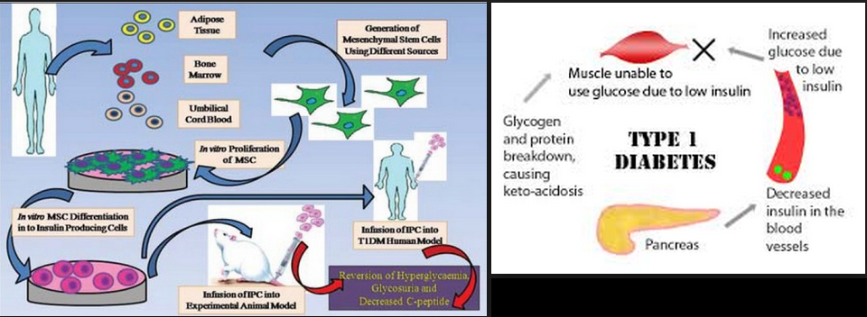
http://i0.wp.com/mirrorsmagazine.com/wp-content/uploads/2015/04/Adipose-Stem-Cell-Therapy-For-Diabetes.png

Slide 8
Leptin and Fatty Cells
The hormone leptin has a well-recognized role in glucose homeostasis (3). Recent studies have demonstrated that high-dose leptin administration reverses hyperglycemia and dyslipidemia in type 1 diabetic rodent models.
The hormone leptin has profound glucose-lowering and insulin-sensitizing action in type 1 diabetic rodent models. We hypothesized that leptin administration could reduce the dose of
transplanted islets required to achieve metabolic control in a mouse model of type 1 diabetes
We then administered 1 mg/day leptin to diabetic mice that underwent transplantation of 50 or 125 islets
Although these islet doses were insufficient to ameliorate hyperglycemia alone, co-administration of leptin with islet transplantation robustly improved control of glucose and lipid metabolism, without increasing circulating insulin levels. This study reveals that low-dose leptin administration can reduce the number of transplanted islets required to achieve metabolic control in STZ-induced diabetic mice. In Diabetes 62:2738–2746, 2013

Slide 9
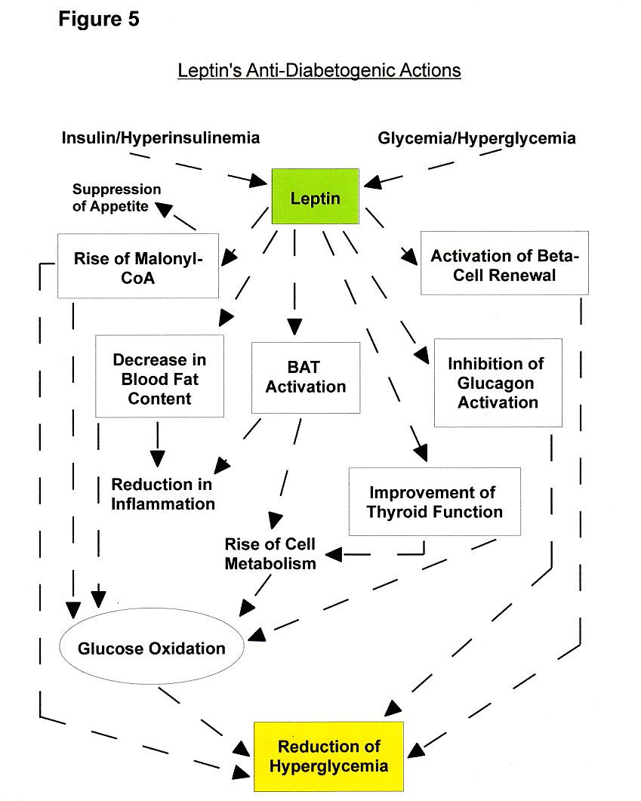
Source: http://www.supplements-and-health.com/images/Garcinia-Cambogia-Side-Effects-Leptin-Benefits-For-Diabetics.jpg

Slide 10
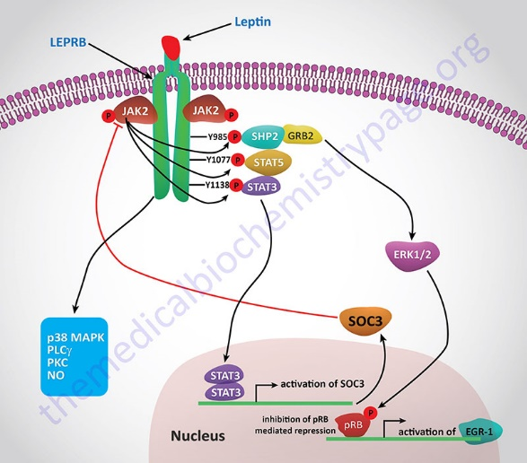
STAT protein=Signal transduction and activator of transcription
SHP-2 is a cytoplasmic SH2 domain containing protein tyrosine phosphatase,
GRB2=Growth factor receptor-bound protein 2
SOC3= suppressor of Cytokine signaling, member of STAT induce STAT cytokine inhibitor SOCS
ERK1/2- mitogen activated protein kinase

Slide 11
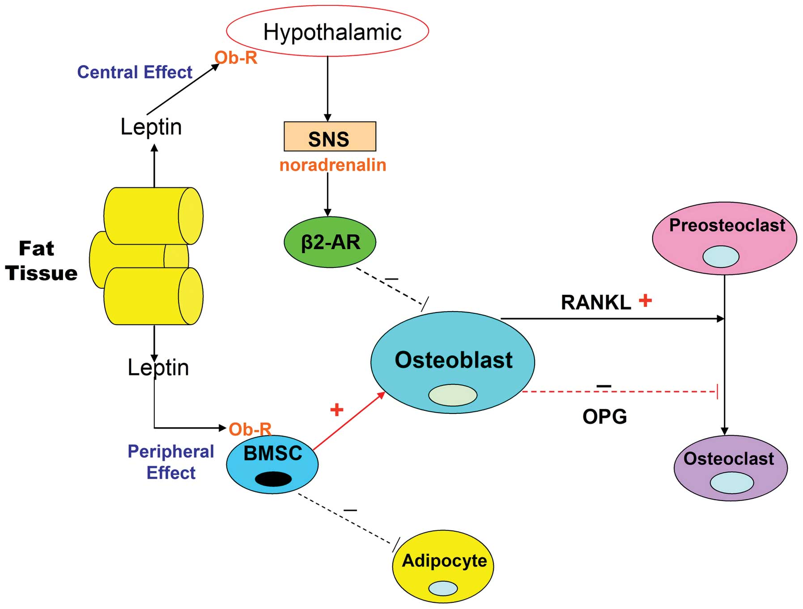
Source: http://www.spandidos-publications.com/article_images/mmr/12/1/MMR-12-01-0783-g01.jpg

Slide 12
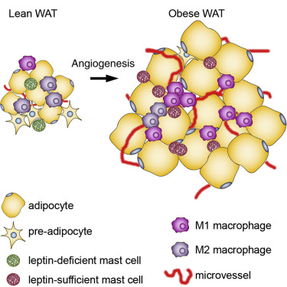
http://www.cell.com/cms/attachment/2040687477/2054357906/fx1.jpg

Slide 13
Mast cells (MCs) contribute to the pathogenesis of obesity and diabetes. This study demonstrates that leptin deficiency slants MCs toward anti-inflammatory functions. MCs in the white adipose tissue (WAT) of lean humans and mice express negligible leptin. Adoptive transfer of leptin-deficient MCs expanded ex vivo mitigates diet-induced and pre-established obesity and diabetes in mice. Mechanistic studies show that leptin-deficient MCs polarize macrophages from M1 to M2 functions because of impaired cell signaling and an altered balance between pro- and anti-inflammatory cytokines, but do not affect T cell differentiation. Rampant body weight gain inob/ob mice, a strain that lacks leptin, associates with reduced MC content in WAT. In ob/obmice, genetic depletion of MCs exacerbates obesity and diabetes, and repopulation of ex vivo expanded ob/ob MCs ameliorates these diseases.

Slide 14
Conclusions
Adipocytes can be transformed into beta like cells by reprogramming of the fatty cells, usually
with the aid of lentivirus
2. Leptin can help the regeneration process.

